Slide 1
Abenomics
Michelle Loo 6T

Slide 2
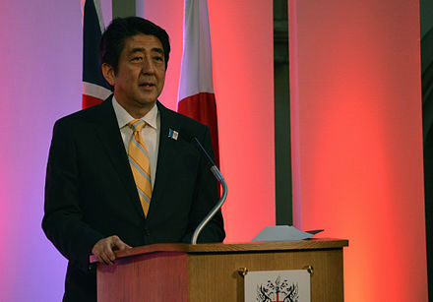
Content
What is Abenomics?
The economic policies advocated by the Prime Minister of Japan, Shinzō Abe, since December 2012, based upon "three arrows" of monetary policies, fiscal policies and structural reforms.
Background
Shinzō Abe’s Three Arrows
Monetary policy
Fiscal policy
Structural reforms
Economic Outlook
Inflation
GDP
Unemployment rate
Shinzō Abe, the prime Minister of Japan, Dec. 2012 – Present
Source: https://en.wikipedia.org/wiki/Abenomics

Slide 3
Three Arrows Approach
A
Monetary Policy
B
Fiscal Policy
C
Structural Reforms
Purpose:
Exit from deflation
Boost economic recovery

Slide 4
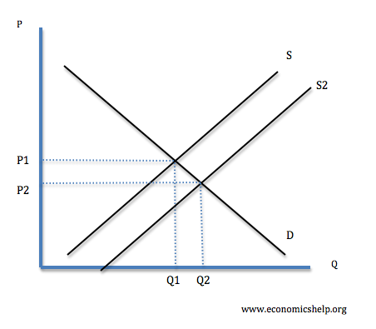
Monetary Policy
Target: 2% inflation
Method:
Quantitative and qualitative monetary easing
Purchasing Japanese government bonds (JGBs), exchange-traded funds (ETFs) and Japan real estate investment trusts (J-REITs), CP and corporate bonds
Effects:
Money supply ↑ → Depreciation ↑ → Import ↑ → Oil price ↑ → Inflation ↑

Slide 5
Fiscal Policy
Raised consumption tax
Consumption tax rate raised from 5% to 8% in April 2014. Plan to increase to 10% in 2019.
All of the increased revenue is used for Social Security.
Consumption tax rate
Previous | 5%
April 2014 | 8%
2019 | 10%

Slide 6
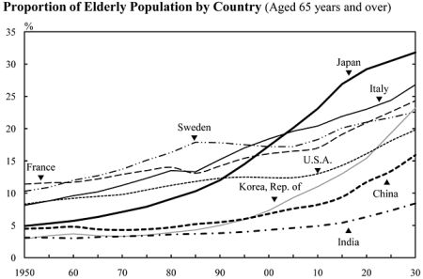
Structural Reforms
The most serious issue:
Lack of labor force
Labor participation in 2014
Total: 59.4%
Men: 70.4%
Women: 49.2%

Slide 7
Structural Reforms
Solutions
More female employees
More foreign employees
Infrastructure development that supports women in the workforce:
① Open more childcare centers by utilizing a rental system and Government-owned land
② Secure childcare workers to sustain the growing demand
③ Advanced implementation of new schemes including subsidies for small scale childcare businesses
④ Assistance for unregistered childcare centers that are seeking registration
⑤ Support for on-site childcare centers on business premises

Slide 8
Supporters of Abenomics (2013)
J. Stiglitz
Depreciating yen to end deflation is the right policy. Just as I recommended 10 years ago.
Paul Krugman
I evaluate Abenomics highly; no other country could do this policy mix.
IMF Managing Director Lagarde
Inflation target of 2% is desirable as long as central bank independence is secured.
Fed Chairman Bernanke
I support it as a policy to end deflation.
Prof. Koichi Hamada (Abe’s advisor)
Don’t worry about recent stock market drops—they are just corrections of excess optimism. The real economy is improving.
Prof. Takatoshi Ito (GRIPS)
BOJ economists think QE is ineffective. But many researchers and officials support QE as a tool to change inflation expectation.

Slide 9
Critiques of Abenomics (2013)
George Soros (investment guru)
Japan’s monetary policy is bold but very risky; it may trigger a collapsing yen.
Prof. Kunio Okina (Kyoto Univ.)
If deflation mind is dispelled but fiscal discipline is not secured, monetization of fiscal deficit will generate a serious dilemma between financial stability and price stability.
Kazuo Ueda (Tokyo Univ.)
Monetary expansion increased interest & yen volatility. If long-term interest rates rise, expected positive impact on real economy will not happen.
Ryutaro Kono (BNP Paribas)
The monetary transmission mechanism is broken. Under such circumstances, monetary expansion may destabilize asset prices, raise long-term interest rates, and put BOJ in a macro policy dilemma.
Nikkei Newspaper commentary
The growth strategy lists only easy measures; bold reforms in such key areas as medical service, agriculture, corporate tax rates, etc. are not clarified.

Slide 10
Economic Outlook
Consumer price index
( % / year )
Inflation:
When can it reach 2%?
2015 → 2016 → 2017
Effected largely by the crude oil
Employees’ wages did not grow much

Slide 11
Economic Outlook
Actual consumer inflation (all items) was +2.7% (2014), +0.8% (2015) and -0.1% (2016) missing the 2% target by a wide margin.
BOJ extended the target beyond the second year, shifted from zero to negative interest rate policy, introduced a policy rule centered on long-term interest rates, then finally admitted that 2% inflation might be unrealistic for some time to come.
Low inflation is blamed on the declining global oil price, the negative impact of consumption tax increase and uncertainty surrounding the growth potential of emerging economies.

Slide 12
Economic Outlook
GDP growth:
Why is Japan’s potential growth rate so low?
Lack of labor force
Effect of stagnation
Will Japan’s GDP grow quickly?
Unlikely, unless potential GDP grows

Slide 13
Economic Outlook
Unemployment rate:
Unemployment rate has fallen to below 4%, the lowest level since October 2008
The participation rate of women in the labor force is increasing dramatically

Slide 14
Evaluation
Critics argue that Abenomics brings major risks. Some think monetary policy could spur hyperinflation and some are worried about Japan’s national debt, which, at over one quadrillion yen, has surpassed 245% of its GDP. The International Monetary Fund (IMF) has repeatedly warned that these debt levels are unsustainable.
That’s why Abe has attempted to reduce the deficit by raising taxes. An increase in the national consumption tax from 5 to 8% futher depressed consumer spending and likely caused recession. As a result, the next planned bump, up to 10%, has been continuously postponed, first to 2017 and then to 2019.

Slide 15
Evaluation
At the same time, negative interest rates, a relatively untested monetary tool, give many economists pause. The BOJ was split five to four on the decision over worries that the policy could damage the banking system. Some worry that negative rates might not actually encourage spending, but rather, the hoarding of cash, thus adding to deflationary pressures.

Slide 16
Conclusion
Japanese yen has weakened but the trade position has worsened
Corporate profits have grow strongly
The consumption tax has hit household spending and lowered short term growth
Unemployment is down to 3.6% and there are signs that firms are willing and able to raise wages
Nearly one million women have joined the labour force in the last year
Little progress in cutting the budget deficit because of 2014 economic slowdown

Slide 17
References
https://en.wikipedia.org/wiki/Abenomics
https://www.boj.or.jp/en/mopo/measures/mkt_ope/ope_t/index.htm/
http://www.bbc.com/news/business-36423218
http://japan.kantei.go.jp/ongoingtopics/pdf/2014/140603_abenomics.pdf
https://asia.nikkei.com/Politics-Economy/Economy/Abenomics-Japan-s-popular-ticking-time-bomb
https://www.boj.or.jp/en/announcements/press/koen_2016/ko160413a.htm/

