Slide 1
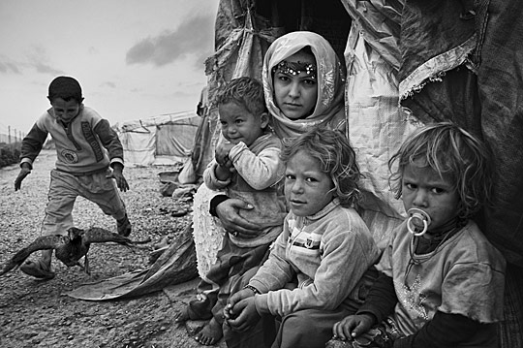
Income Inequality
Michelle Ho 6L (5)

Slide 2
Content
Definition of Income Inequality
Income Distribution Measurement
Current Situation of Hong Kong
Limitations of Income Distribution Measurement
Sources of Income Inequality
Solutions to the Problem

Slide 3
Definition of Income Inequality
Income inequality refers to the extent to which income is distributed in an uneven manner among a population. It can be measured among individuals in a group, among groups in a population, or among countries. By measuring income inequality, we refer to the examine of the fairness in income distribution.
Economic inequality varies between societies, historical periods, economic structures and systems. The term can refer to cross sectional distribution of income or wealth at any particular period, or to the lifetime income and wealth over longer periods of time.

Slide 4
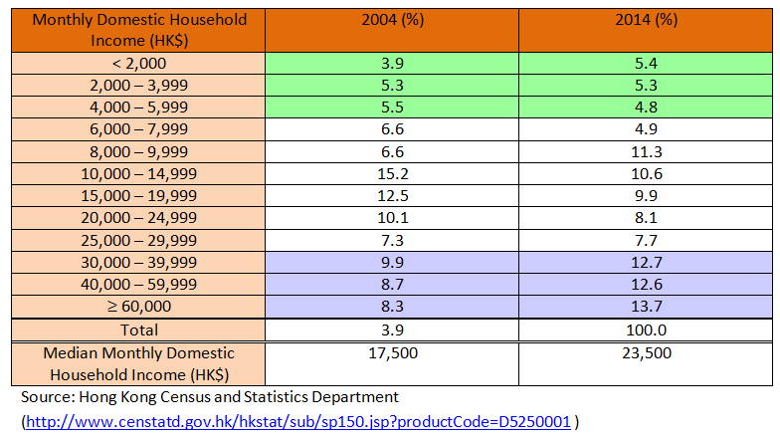
Income Distribution Measurement
Income Group
An income group is a segment of the population whose income falls within a certain range.
From the income group table, we can see the proportion of citizens earning each range of income. In an income table where data is shown in percentages, comparisons among years can easily be made.

Slide 5
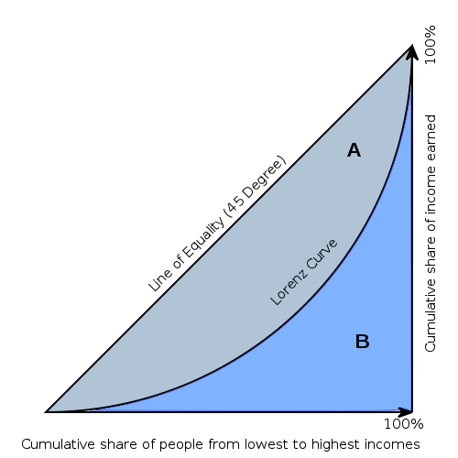
B. Lorenz Curve
The Lorenz curve is a graphical representation of the cumulative distribution function of the empirical probability distribution of wealth or income for representing inequality of the wealth distribution.
To draw the Lorenz Curve, one plots the cumulative percentages of household income against the cumulative percentage of households, starting from the households with the lowest income.
Some cases demonstrated by the Lorenz Curve:

Slide 6
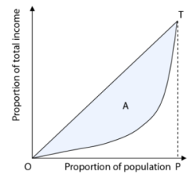
C. Gini Coefficient
Gini index measures the extent to which the distribution of income or consumption expenditure among individuals or households within an economy deviates from a perfectly equal distribution. It has been the most popular method for calculating income inequality in the public health literature.
The Gini coefficient measures the ratio of the area between the 45- degree line and the Lorenz curve to the total area below the 45-degree line.
Area of A__
Gini Coefficient = Area of OTP
Case 1: Gini Coefficient = 0
This is an extreme case where every household earns an equal share of the society’s total income. In this case, the Lorenz curve and the 45 – degree line coincides, and there exists no blue area between the two. This is a situation of absolute income equality.

Slide 7
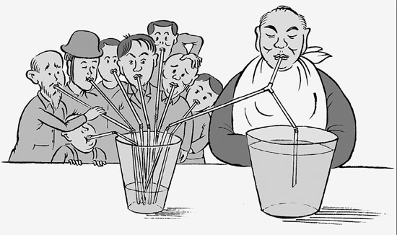
Case 2: Gini Coefficient = 1
This is another extreme case where one household earns all the income and the remaining households earn nothing. In this case, the blue area A is the same as the total triangular area below the 45- degree line (Area OPT). This is a situation of complete income disparity.
Case 3: 0 < Gini Coefficient < 1
This shows the case of unequal income distribution which lies between the two extreme cases. In this case, the Gini coefficient lies between 0 and 1. When income is more unequally distributed, the value of the Gini coefficient will be closer to one. Vice versa, when income is more equally distributed, the value of the Gini coefficient will be closer to zero.

Slide 8
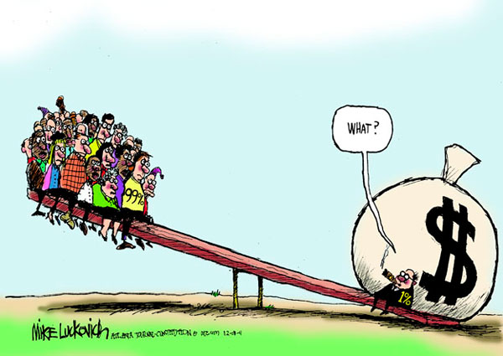
Other methods to measure income inequality:
Atkinson index
Coefficient of variation
Decile ratios
Generalised entropy (GE) index
Kakwani progressivity index
Proportion of total income earned
Robin Hood index
Sen poverty measure

Slide 9
Hong Kong’s Current Situation
Hong Kong’s Gini coefficient has been worsening: in 1996, it was 0.518; in 2001, it was 0.525; and 10 years on, in 2011, it was 0.537.
When compared to five other developed countries – Canada, Britain, the United States, Singapore and Australia. Hong Kong fared the worst, with a Gini coefficient of 0.537 compared with Singapore’s 0.482 and the United States’ 0.469.
Values above 0.4 are generally seen as a warning that social inequality as calculated by economist and professors. Therefore, it can be concluded that Hong Kong’s income distribution is very unevenly distributed, the wealth gap is widening and has become a social problem to us.

Slide 10
Limitations of Income Distribution Measurement
Impact of the change in household size on income disparity Big families were common in Hong Kong in the past. But nowadays, there are many small families, leading to a continuous decline in average household size. This tends to reduce household income. The upsurge of elderly households has led to a rapid rise in the number of low-income families. Many old people are living separately from their children. Many of them are supported by their savings and their children, with social security allowance as subsidy. If these elderly people are still living with their children or grandchildren, they will not statistically be counted as low-income families.

Slide 11
2. Impact of higher education and professional level on income disparity Hong Kong’s economy is continuously restructuring towards higher value-added activities, and is creating many high-income jobs in the process. As the number of people with tertiary education and workers at supervisory and professional level grows, income distribution in Hong Kong is affected:
(1) The income disparity between high-income and low-income jobs is widening.
(2) The proportion of high-income workers increases and this leads to an increase in the value of the Gini Coefficient.
(3) The income disparity among high-income earners is larger than the gap among the lower-skilled workers.
(4) On average, the income of lower-income workers will gradually decrease when they reach middle age, but the income of middle-aged workers with higher salaries will continue to increase. As a result, income disparity in Hong Kong will widen with the ageing of the population.

Slide 12
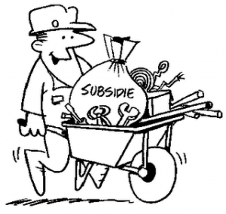
3. The role of the government in income redistribution and the Gini Coefficient
The Government provides various services in education, medical care, housing and CSSA, and these services redistribute income. Income tax and property tax also serve the function of income redistribution. After taking into account the redistributive effect of these services and taxes, the household income of a large majority of families in Hong Kong, including many “middle class families”, would be higher. Comments that make comparisons between Hong Kong’s Gini Coefficient and overseas data often forget that the definition of data varies in different places. For instance, the Gini Coefficient published by Hong Kong was based on income data that mixed the general household income with CSSA receipts without deducting income tax. The income data used by many other places is derived after deducting different types of taxes. Some economies also take into account the impact of the Government’s functions of income redistribution in arriving at their figure. In the circumstances, direct comparison between Hong Kong’s Gini Coefficient and those of overseas places may result in a wrong conclusion.

Slide 13
4. Difficulty in collecting income data
Some households may conceal their income. Some people may work overtime and earn extra income, but not report this to the government. Informal transaction (e.g. selling goods to relatives) and illegal activities (e.g. smuggling of goods) are also not recorded.
5. Different definitions of income
There are different definitions of income. Some people may count income from their full-time employment only. Others may include income from their part-time jobs, income given by grown-up children, etc. Moreover, some people may consider wage income only, while others may include income from other sources like rental, interest and dividend incomes.

Slide 14
Sources of Income Inequality
Labour Quality Differences Income differences often reflect the qualities of workers. Workers have different qualities, such as different skills, appearance, attitudes, levels of intelligence, etc. Employers prefer to hire those with more attractive qualities.
Working Condition Differences Differences in wages may also reflect differences in working conditions. Working conditions include the personality and behaviour of the employers and fellow workers, health risks, job facilities, location, prospects, and so on. As employees tend to choose employers who can provide better working conditions, to attract workers to accept jobs with poorer working conditions, employers have to pay high wages.
Differences in Human Capital The greater the amount of human capital, the higher the productivity of labour. Therefore, differences in incomes may just reflect differences in the amount of human capital owned by different workers. Workers can invest their time and money to acquire better education and training. This investment in human capital can improve the productivity of workers and increase their future income. So differences in income can also be explained by differences in human capital investment across workers.

Slide 15
IV. Geographical Differences Demand for and supply of the same type of workers may vary between areas. So workers’ incomes are different in different areas. For example, if an area has a larger supply of workers, workers’ incomes on average will be lower.
V. Age Differences The income of a household may be low when children are still at school, but household income will increase when the children grow up and start working.
VI. Sex Differences In general, male workers earn a higher income than female workers. A major cause of this is related to child-bearing, childcare and housekeeping work. Those limit the working experience of some women and makes them less competitive in the labour market.
VII. Unequal Ownership of Land, Capital and Business Wage income is only one source of income. Apart from wage income, households may earn rental and interest income from owning land and capital. Business owners may earn profits and dividends. Hence, one major source of income inequality is the unequal ownership of land, capital and business.

Slide 16
VIII. Monopoly Power and Political Power Some firms can earn high profits because they possess monopoly power. These firms are protected by entry barriers so that other firms are unable to compete with them. Electricity companies in Hong Kong are example of natural monopolist. They can earn high profits from economies of scale in production. Meanwhile, some firms may have political power and can obtain monopoly rights granted by the government. For example, professionals, such as doctors and lawyers, are protected by entry barriers. An example of an entry barrier is professional membership. People from other countries or those who are not members of professional bodies are not allowed to provide those services. As a result of reduced competition, these professionals can earn a higher income.
IX. Discrimination in Labour Market Income inequality may be the result of discrimination against certain categories of workers (such as women, ethnic minorities, the elderly, etc.) by employers in the labour market. However, in a market with free competition, if an employer discriminates against certain categories of workers and pays them less than the market wages, the firm will not be able to employ them. Similarly, if an employer favours certain categories of workers and pays them more than the market wages, the production costs of the firm will increase. This will reduce the competitiveness of the firm in the market. Therefore, firms which discriminate against certain categories of workers have to pay a cost for discrimination. This explains why discrimination is not common in a free market.

Slide 17
Solutions to the Problem
Taxes and Transfer The government can reduce income inequality through imposing taxes on the rich and using the tax revenue to help the poor. Apart from giving cash payments, the government can provide low-income households with subsidised housing and medical services. These social welfare services can help improve the living standards of the poor.
Minimum Wage Legislation Many countries have already implemented the minimum wage law. By imposing the law, the income earned by the low income group can thus be secured.
Education and Training Investments in human capital like education and training can improve the skills and productivity of workers. The government can provide retraining programmes to help unemployed workers find jobs and earn a higher income.
Donations and Foreign Aid The government can encourage rich people to donate money to help improve the skills of the poor. For example, rich people can provide scholarships to poor students. The government can also encourage the establishment of social enterprises. Instead of profit-making, these enterprises aim to provide employment opportunities and training to unskilled workers.

Slide 18
Bibliography
inequality.org, Income Inequality:
http://inequality.org/income-inequality/
BusinessDictionary.com, income group:
http://www.businessdictionary.com/definition/income-group.html
NCBI, Income Inequality Measures:
http://www.ncbi.nlm.nih.gov/pmc/articles/PMC2652960/
Income Distribution of Hong Kong and the Gini Coefficient, KWOK Kwok Chuen: https://www.google.com.hk/url?sa=t&rct=j&q=&esrc=s&source=web&cd=1&cad=rja&uact=8&ved=0CBsQFjAA&url=http%3A%2F%2Fwww.eabfu.gov.hk%2Fen%2Fpdf%2Fincome.pdf&ei=qyyKVcCcDoSwmAWOqqPADw&usg=AFQjCNHhWaUpBW1JAkadXmiLINyrvSl96Q&sig2=i0Bxi0zZ6S9OLCJ4r-hNSA&bvm=bv.96339352,d.dGY
Hong Kong Census and Statistics Department
http://www.censtatd.gov.hk/hkstat/sub/sp150.jsp?productCode=D5250001

